Slide 1



Biography Presentation
Guar Gopal Das
By:
Raghav Maheshwari PF47

Slide 2
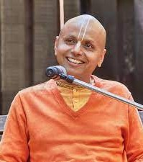
Who is Gaur Gopal Das?
Gaur Gopal Das is an Indian spiritual leader, motivational speaker, and lifestyle coach.
Gaur Gopal Das was born on 24 December 1973, in Maharashtra, India.
He has engineering
done electrical from College Of
Engineering, Pune

Slide 3
Tenure as a Monk
In the year 1996, Das became a member of the International Society for Krishna Consciousness (ISKCON).
Since then, he has been active in the field of spirituality and is continuously working towards the goal of self-realization under the guidance of his Guru Radhanath Swami.
Gaur Gopal Das has inspired many young minds through his quotations, which include ‘Feed your faith and all your doubts shall starve to death’.

Slide 4

Career as a Motivational Speaker
He has spoken at numerous TEDx events and has given lectures at numerous corporates like Barclays, Infosys, Bank of America, Ford, EY.
Gaur Gopal Das is one of the rarest inspirational speakers from the country to have given lectures in the British parliament and Google’s head office.
He has also written several novels and books till date, such as ‘Checkmate,’ ‘Conquest,’ and ‘Revival'.

Slide 5
Achievements
In 2016, he received the Rotary International's Super Achiever Award for his outstanding contribution in the field of spirituality.
He was once awarded the 'Danveer Karna Award' by KIIT University for his selfless contributions to encourage the ideologies of 'Art of Giving'.
His show won the title of Best Spiritual/Motivational Show on the Web by IWM Digital Awards 2018.

Slide 6
THANK YOU

